Slide 1


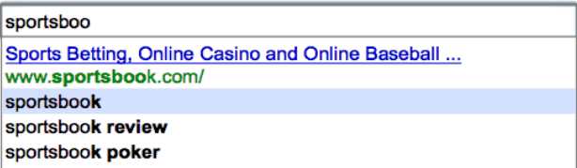
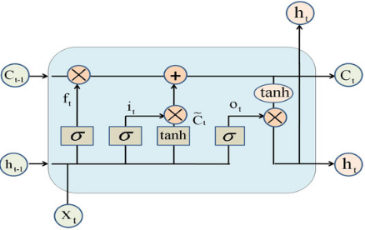
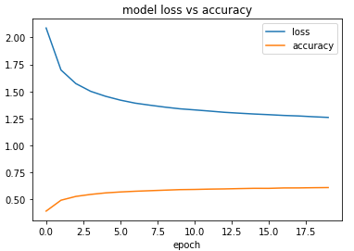

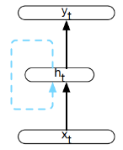


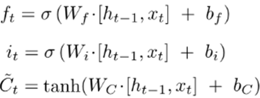
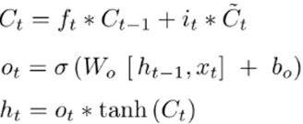
Predict the Next Word in Sentence using Neural Networks
Data Science, Rahul Marru, Manivardhan Reddy Pindi.
rmarru@memphis.edu, mpindi@memphis.edu
Poster ID - 7
As the task's title indicates, language modeling is a method of predicting the words that will appear in a sequence.
It is a task that will predict which word comes next in sequence. It is part of Natural Language Processing and used in Deep learning.
Hence, Deep Learning is functionality
of AI to make choice of decisions made
from set of hidden patterns
similarly to human brain.
According to historical
search data, Google search
recommendations frequently
use the forecast of the next word automatically displayed.
Data
Introduction
The data corpus considered for this problem is collected from an English-language eBook about Project Gutenberg's "The Adventures of Sherlock Holmes," written by author Arthur Conan Doyle.
That contained various sub-contents like stories, documentation, and text data, which are necessary for our problem statement. In addition, we can use a variety of articles as text data for this problem.
Comparison Models:
Graph plot for Model Loss v/s Predicting the Next word using
Accuracy for LSTM it is consistent LSTM model
when compare with Bi-LSTM: Test 1:
T
Test 2:
Result
Model | Accuracy
Recurrent Neural Network (RNN) | 13%
Long Short Term Memory (LSTM) | 54%
Bidirectional LSTM | 54%
BBI
Bi-LSTM is sequence of multiple LSTM units it can get inputs from both previous and after LSTM unit.
Forget gate, Input gate, Output gate, Memory unit
Model Architecture of RNN, LSTM & Bi-LSTM
RNN Unit
LSTM Unit
Following steps to implementing:-
Load required packages and data from corpus.
Feature Engineering
Building the model.
Training, Evaluating and Testing the model.
Predicting the next word for a sentence using best model.
Using Packages Keras, Tensorflow, Model – sequential {Simple RNN, LSTM, Bidirectional, Dense. Activation} layers, Text Feature engineering with text data is converting the string into numerical values. Applying train-test split and implementing the model with training data. Finding accuracy and loss with test data.
Experiment Design
Key takeaways & Conclusion
There are various applications for this language modeling in real world like automatic word while chatting in keyword, auto correction in emails major usage in daily life.
To conclude that , the accuracy of model with better and consistent is LSTM. It consumes more time to run for LSTM model, if we train more it can get more better performance. When compare it with baseline previous work it is almost accuracy is near to it, we done by train-test split before applying models and Bi-LSTM are new in our project.
Baseline: Sourabh Ambulgekar, Sanket Malewadikar, Raju Garande, Dr. Bharti Joshi (2021). “Next Words Prediction Using Recurrent Neural Networks”, ICACC conference. Source:
https://www.researchgate.net/publication/353773522_Next_Words_Prediction_Using_Recurrent_NeuralNetworks
.
Data Source: https://drive.google.com/file/d/1GeUzNVqiixXHnTl8oNiQ2W3CynX_lsu2/view
*Size of this logo is notably smaller than the primary Washington University logo in header.
Outside entity logo,
if needed*
Example 3: Funding provided by the American Physical Therapy Association’s xxxxxxxx Program.

